Slide 1
Linear regression: tutorial 2
Adnane Ez-zizi
18/04/2018

Slide 2
Outline
Simple linear regression: confidence intervals
Multiple linear regression model
Multiple linear regression versus multiple simple linear regression
The F-test for model comparison
Modelling interactions between the predictors

Slide 3
Recap from last time

Slide 4
Let's recap from last time
Example:
We have data about the sales of a product in 200 different markets, along with advertising budgets for three different media: TV, radio, and newspaper.
Advertising <- read.csv("http://www.bcf.usc.edu/~gareth/ISL/
Advertising.csv")
head(Advertising, n=3)
X TV radio newspaper sales
1 1 230.1 37.8 69.2 22.1
2 2 44.5 39.3 45.1 10.4
3 3 17.2 45.9 69.3 9.3

Slide 5

Simple linear regression: fit in R
fit.TV = lm(sales ~ TV, data = Advertising)
summary(fit.TV)
Call:
lm(formula = sales ~ TV, data = Advertising)
Residuals:
Min 1Q Median 3Q Max
-8.3860 -1.9545 -0.1913 2.0671 7.2124
Coefficients:
Estimate Std. Error t value Pr(>|t|)
(Intercept) 7.032594 0.457843 15.36 <2e-16 ***
TV 0.047537 0.002691 17.67 <2e-16 ***
---
Signif. codes: 0 '***' 0.001 '**' 0.01 '*' 0.05 '.' 0.1 ' ' 1
Residual standard error: 3.259 on 198 degrees of freedom
Multiple R-squared: 0.6119, Adjusted R-squared: 0.6099
F-statistic: 312.1 on 1 and 198 DF, p-value: < 2.2e-16
${Sales}_{i}=7.0326+0.0476×{TV}_{i}$
Average error
Proportion of
Variance explained by the model

Slide 6
Questions we can answer using simple linear regression
Is there a relationship between TV advertising budget and sales?
-> Yes, the regression coefficient suggests that the sales are positively related to TV advertising budget---the more you spend in TV advertising, the higher the sales. Also, the effect of TV advertising on sales is robust since the coefficient is significantly different from 0.
If yes, how strong is this relationship?
-> The percentage error is 23% (RSE/mean(Y)).
-> TV advertising budget can explain 61% of the variability in the sales.

Slide 7
Questions we can answer using simple linear regression
How accurately can we estimate the effect of TV advertising on sales?
-> The standard error (SE) of the TV coefficient is 0.002691, which represents less than 6% of the coefficient estimate.
-> We can also use the standard error to construct what we call a confidence interval for the TV coefficient, instead of producing a unique point estimate, such that we will be pretty sure that the true coefficient will be in the interval.

Slide 8
Task:
Load the mlu data set
Build a simple linear regression model to try to explain the mother’s mlu as a function of the child’s mlu.
What can you conclude?

Slide 9
Confidence intervals

Slide 10
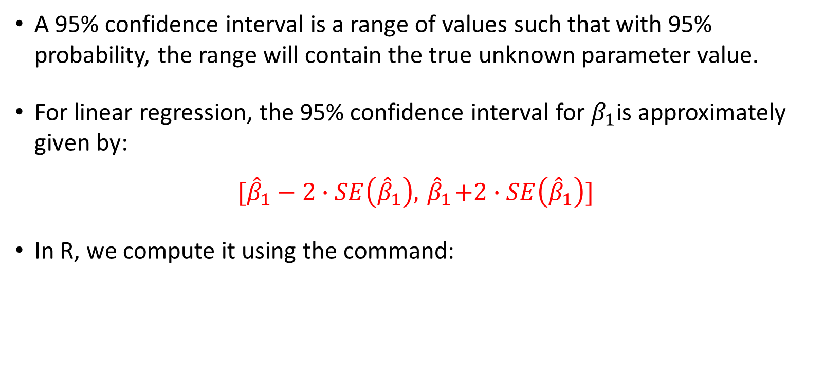
Confidence intervals
A 95% confidence interval is a range of values such that with 95% probability, the range will contain the true unknown parameter value.
For linear regression, the 95% confidence interval for $β_{1}$is approximately given by:
$$[{\hat{β}}_{1}−2∙SE\left({\hat{β}}_{1}\right), { \hat{β}}_{1}+2∙SE\left({\hat{β}}_{1}\right)]$$
In R, we compute it using the command:
confint(fit1, "TV")
2.5 % 97.5 %
TV 0.04223072 0.05284256

Slide 11
Task:
Construct a 95% confidence interval for the regression coefficient of chi.

Slide 12
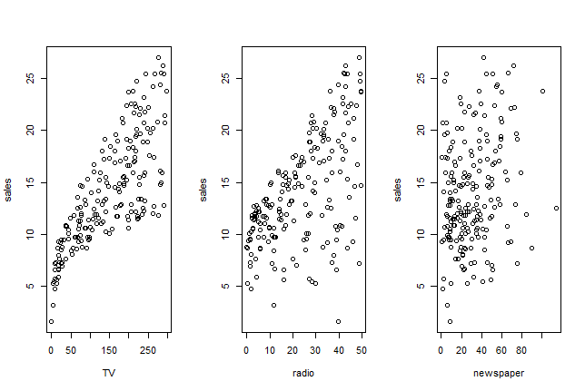
Multiple linear regression model
In our advertising example, we have looked only at the effect of TV advertising on sales. What if we want to know if radio and newspaper advertising are also effective? Or maybe even more effective?

Slide 13
Multiple simple regression models (TV)
fit.TV = lm(sales ~ TV, data = Advertising)
summary(fit.TV)
Call:
lm(formula = sales ~ TV, data = Advertising)
Residuals:
Min 1Q Median 3Q Max
-8.3860 -1.9545 -0.1913 2.0671 7.2124
Coefficients:
Estimate Std. Error t value Pr(>|t|)
(Intercept) 7.032594 0.457843 15.36 <2e-16 ***
TV 0.047537 0.002691 17.67 <2e-16 ***
---
Signif. codes: 0 '***' 0.001 '**' 0.01 '*' 0.05 '.' 0.1 ' ' 1
Residual standard error: 3.259 on 198 degrees of freedom
Multiple R-squared: 0.6119, Adjusted R-squared: 0.6099
F-statistic: 312.1 on 1 and 198 DF, p-value: < 2.2e-16

Slide 14
Multiple simple regression models (Radio)
fit.radio = lm(sales ~ radio, data = Advertising)
summary(fit.radio)
Call:
lm(formula = sales ~ radio, data = Advertising)
Residuals:
Min 1Q Median 3Q Max
-15.7305 -2.1324 0.7707 2.7775 8.1810
Coefficients:
Estimate Std. Error t value Pr(>|t|)
(Intercept) 9.31164 0.56290 16.542 <2e-16 ***
radio 0.20250 0.02041 9.921 <2e-16 ***
---
Signif. codes: 0 ‘***’ 0.001 ‘**’ 0.01 ‘*’ 0.05 ‘.’ 0.1 ‘ ’ 1
Residual standard error: 4.275 on 198 degrees of freedom
Multiple R-squared: 0.332, Adjusted R-squared: 0.3287
F-statistic: 98.42 on 1 and 198 DF, p-value: < 2.2e-16

Slide 15
Multiple simple regression models (Newspaper)
fit.news = lm(sales ~ newspaper, data = Advertising)
summary(fit.news)
Call:
lm(formula = sales ~ newspaper, data = Advertising)
Residuals:
Min 1Q Median 3Q Max
-11.2272 -3.3873 -0.8392 3.5059 12.7751
Coefficients:
Estimate Std. Error t value Pr(>|t|)
(Intercept) 12.35141 0.62142 19.88 < 2e-16 ***
newspaper 0.05469 0.01658 3.30 0.00115 **
---
Signif. codes: 0 ‘***’ 0.001 ‘**’ 0.01 ‘*’ 0.05 ‘.’ 0.1 ‘ ’ 1
Residual standard error: 5.092 on 198 degrees of freedom
Multiple R-squared: 0.05212, Adjusted R-squared: 0.04733
F-statistic: 10.89 on 1 and 198 DF, p-value: 0.001148

Slide 16
Problems
Not clear how we can make a single prediction of sales given the budget of each advertising medium?
When estimating each coefficient, we ignored the other two media. This can lead to very misleading estimates of the individual media effects on sales if there are correlations between the predictors.

Slide 17
Multiple linear regression

Slide 18
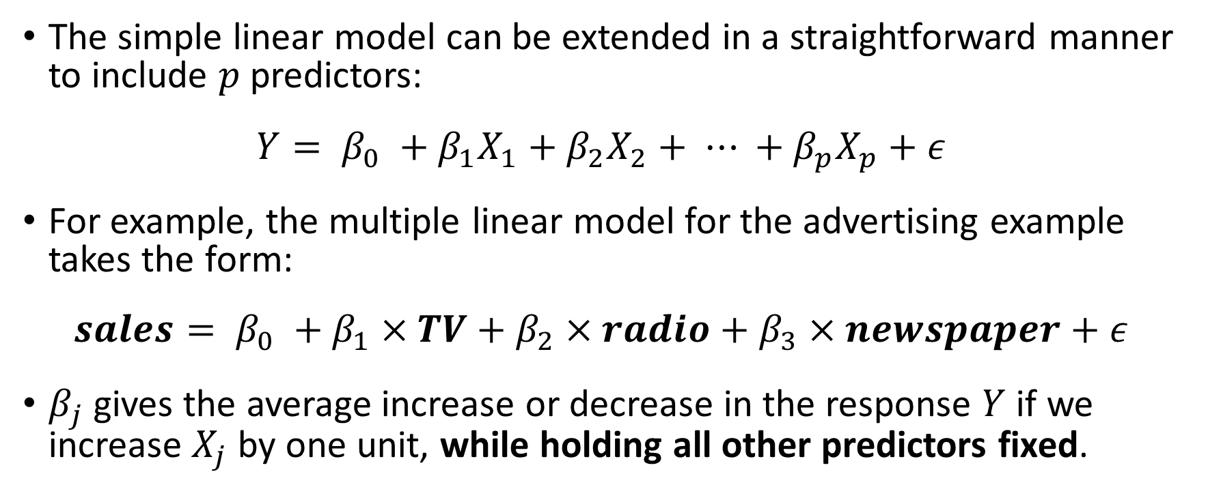
Multiple linear regression model
The simple linear model can be extended in a straightforward manner to include $p$ predictors:
$$Y= β_{0} +β_{1}X_{1}+β_{2}X_{2}+ ⋯ +β_{p}X_{p}+ε$$
For example, the multiple linear model for the advertising example takes the form:
$$sales= β_{0} +β_{1}×TV+β_{2}×radio+β_{3}×newspaper+ε$$
$β_{j}$gives the average increase or decrease in the response $Y$ if we increase $X_{j}$ by one unit, while holding all other predictors fixed.
Notes:
Additivity assumption: The effect of each predictor is independent of the value of the other predictors

Slide 19
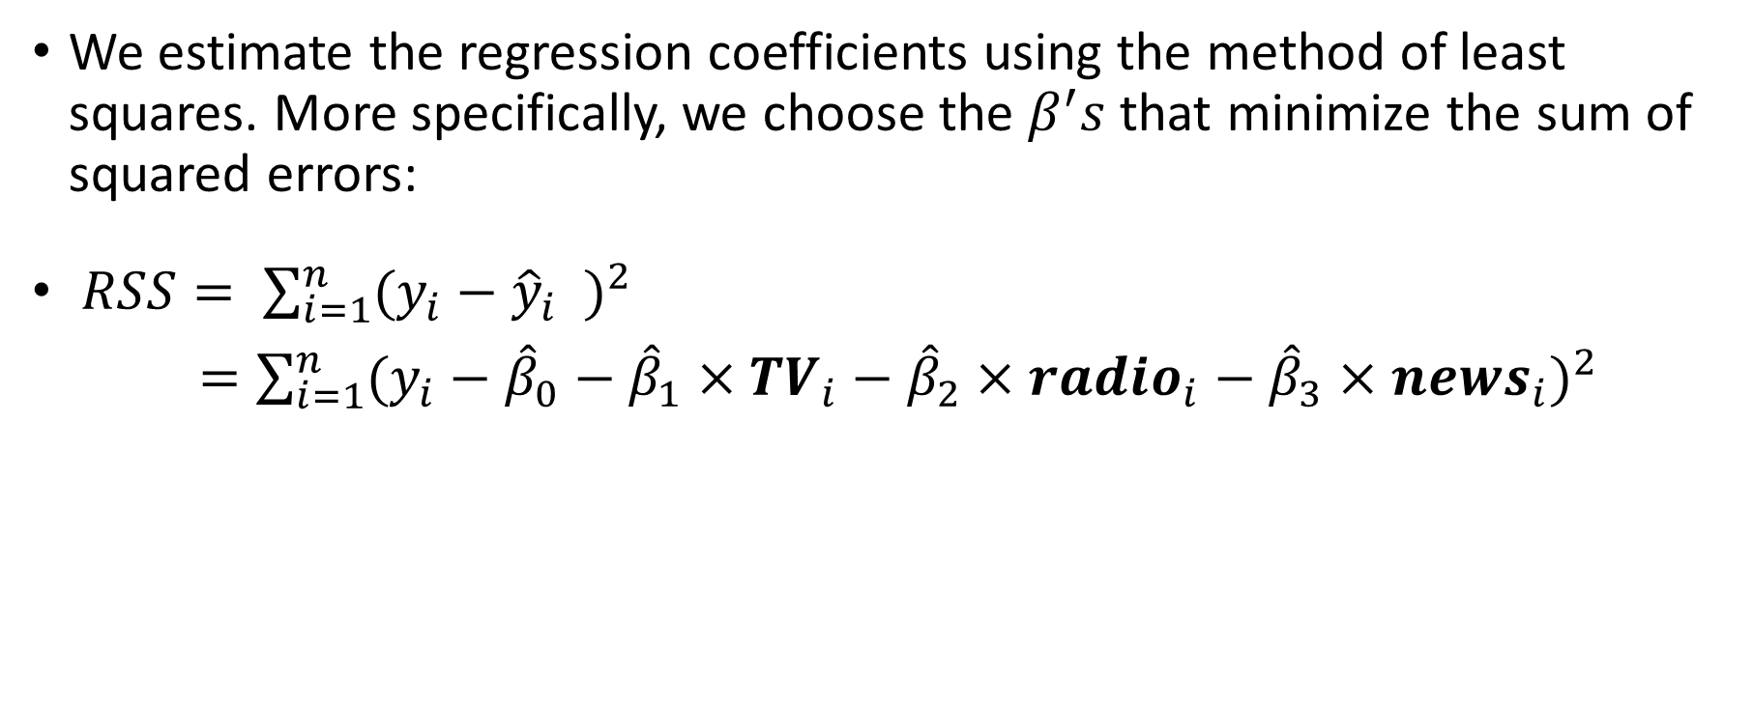
Multiple linear regression model: Estimating the coefficients
We estimate the regression coefficients using the method of least squares. More specifically, we choose the $β^{′}s$that minimize the sum of squared errors:
$RSS= \sum_{i=1}^{n}{{(y_{i}−{\hat{y}}_{i} )}^{2}}$
$=\sum_{i=1}^{n}{{(y_{i}−{\hat{β}}_{0}−{\hat{β}}_{1}×{TV}_{i}−{\hat{β}}_{2}×{radio}_{i}−{\hat{β}}_{3}×{news}_{i})}^{2}}$

Slide 20
Multiple linear regression in R
lm.fit = lm(sales ~ TV + radio + newspaper, data = Advertising)
summary(lm.fit)
Call:
lm(formula = sales ~ TV + radio + newspaper, data = Advertising)
Residuals:
Min 1Q Median 3Q Max
-8.8277 -0.8908 0.2418 1.1893 2.8292
Coefficients:
Estimate Std. Error t value Pr(>|t|)
(Intercept) 2.938889 0.311908 9.422 <2e-16 ***
TV 0.045765 0.001395 32.809 <2e-16 ***
radio 0.188530 0.008611 21.893 <2e-16 ***
newspaper -0.001037 0.005871 -0.177 0.86
---
Signif. codes: 0 ‘***’ 0.001 ‘**’ 0.01 ‘*’ 0.05 ‘.’ 0.1 ‘ ’ 1
Residual standard error: 1.686 on 196 degrees of freedom
Multiple R-squared: 0.8972, Adjusted R-squared: 0.8956
F-statistic: 570.3 on 3 and 196 DF, p-value: < 2.2e-16
Notes:
What do you notice here?

Slide 21
Multiple linear regression in R: Coefficients
The coefficients of TV and radio budgets are positive and significant, suggesting that as you increase the spending on TV or radio advertising, sales go up.
The coefficient of newspaper budget is no longer significant and is near 0, suggesting that newspaper advertising has no effect on sales.
The multiple regression coefficient estimates for TV and radio are similar to those of the simple regression. This is not true for newspaper:

Slide 22
Multiple linear regression in R: Coefficients
Multiple linear regression model:
Simple linear regression Models
(Intercept) TV radio newspaper
2.9389 0.0458 0.1885 -0.0010
(Intercept) TV
7.0326 0.0475
(Intercept) radio
9.3116 0.2025
(Intercept) newspaper
12.3514 0.0547

Slide 23
Why does the coefficient for newspaper different in the two models?
Consider the correlation matrix (in R, use cor(Advertising[, 2:5])):
-> In markets where we spend more on radio, sales will tend to be higher,
and also newspaper advertising will be higher.
So if we build a simple linear regression that looks at the relationship between sales and newspaper ignoring radio, we might find that high values of newspaper advertising tend to be associated with higher values of sales, even though newspaper advertising does not affect sales.
TV radio newspaper sales
TV 1.0000 0.0548 0.0566 0.782
radio 0.0548 1.0000 0.3541 0.576
newspaper 0.0566 0.3541 1.0000 0.228
sales 0.7822 0.5762 0.2283 1.000

Slide 24
Multiple regression allows to test the effect of each predictor while controlling for the effect of the other predictors.

Slide 25
Multiple linear regression: Assessing the model fit
lm.fit = lm(sales ~ TV + radio + newspaper, data = Advertising)
summary(lm.fit)
Call:
lm(formula = sales ~ TV + radio + newspaper, data = Advertising)
Residuals:
Min 1Q Median 3Q Max
-8.8277 -0.8908 0.2418 1.1893 2.8292
Coefficients:
Estimate Std. Error t value Pr(>|t|)
(Intercept) 2.938889 0.311908 9.422 <2e-16 ***
TV 0.045765 0.001395 32.809 <2e-16 ***
radio 0.188530 0.008611 21.893 <2e-16 ***
newspaper -0.001037 0.005871 -0.177 0.86
---
Signif. codes: 0 ‘***’ 0.001 ‘**’ 0.01 ‘*’ 0.05 ‘.’ 0.1 ‘ ’ 1
Residual standard error: 1.686 on 196 degrees of freedom
Multiple R-squared: 0.8972, Adjusted R-squared: 0.8956
F-statistic: 570.3 on 3 and 196 DF, p-value: < 2.2e-16
Notes:
Let’s see if the model fit has improved or not by adding radio and newspaper predictors

Slide 26

Multiple linear regression: Assessing the model fit using the $RSE$ and $R^{2}$
The percentage error (RSE/mean(Y)) is 12% (compare it to 23% with the simple linear regression on TV).
By including all three predictors we now explain about 89.7% of the variability in sales, in comparison with 61.2% with TV alone.
To take into account the number of predictors, we should compare the adjusted R squared: 89.6% (full model) versus 61% (TV model).

Slide 27
Task:
Fit a multiple linear regression model for the mlu data

Slide 28
F-test

Slide 29
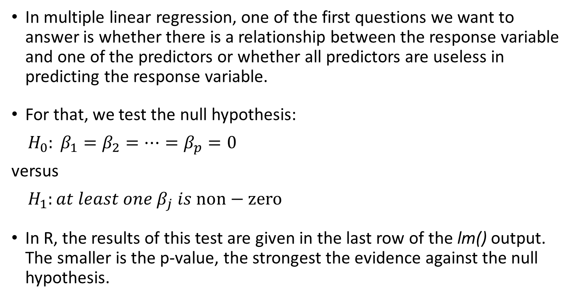
Multiple linear regression: Assessing the model fit using the F-test
In multiple linear regression, one of the first questions we want to answer is whether there is a relationship between the response variable and one of the predictors or whether all predictors are useless in predicting the response variable.
For that, we test the null hypothesis:
$H_{0}: β_{1}=β_{2}=⋯=β_{p}=0$
versus
$H_{1}:at least one β_{j} is non−zero$
In R, the results of this test are given in the last row of the lm() output. The smaller is the p-value, the strongest the evidence against the null hypothesis.

Slide 30
Multiple linear regression: Assessing the model fit using the F-test
Call:
lm(formula = sales ~ TV + radio + newspaper, data = Advertising)
Residuals:
Min 1Q Median 3Q Max
-8.8277 -0.8908 0.2418 1.1893 2.8292
Coefficients:
Estimate Std. Error t value Pr(>|t|)
(Intercept) 2.938889 0.311908 9.422 <2e-16 ***
TV 0.045765 0.001395 32.809 <2e-16 ***
radio 0.188530 0.008611 21.893 <2e-16 ***
newspaper -0.001037 0.005871 -0.177 0.86
---
Signif. codes: 0 ‘***’ 0.001 ‘**’ 0.01 ‘*’ 0.05 ‘.’ 0.1 ‘ ’ 1
Residual standard error: 1.686 on 196 degrees of freedom
Multiple R-squared: 0.8972, Adjusted R-squared: 0.8956
F-statistic: 570.3 on 3 and 196 DF, p-value: < 2.2e-16

Slide 31
F-test for model comparison
The F-test can also be used to compare two “nested” models
anova(fit.TV, lm.fit)
Analysis of Variance Table
Model 1: sales ~ TV
Model 2: sales ~ TV + radio + newspaper
Res.Df RSS Df Sum of Sq F Pr(>F)
1 198 2103
2 196 557 2 1546 272 <2e-16 ***
Notes:
Nested model: all terms of a smaller model occur in a larger model

Slide 32
Interactions between the predictors

Slide 33
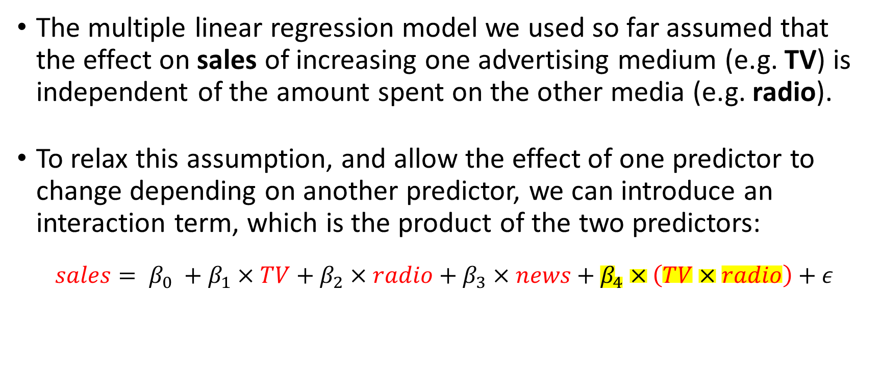
Modelling interactions between the predictors
The multiple linear regression model we used so far assumed that the effect on sales of increasing one advertising medium (e.g. TV) is independent of the amount spent on the other media (e.g. radio).
To relax this assumption, and allow the effect of one predictor to change depending on another predictor, we can introduce an interaction term, which is the product of the two predictors:
$$sales= β_{0} +β_{1}×TV+β_{2}×radio+β_{3}×news+β_{4}×\left(TV×radio\right)+ε$$
Notes:
Go to the model fit summary page and show the average effect on sales of a one-unit increase in TV, regardless of the amount spent on radio.

Slide 34
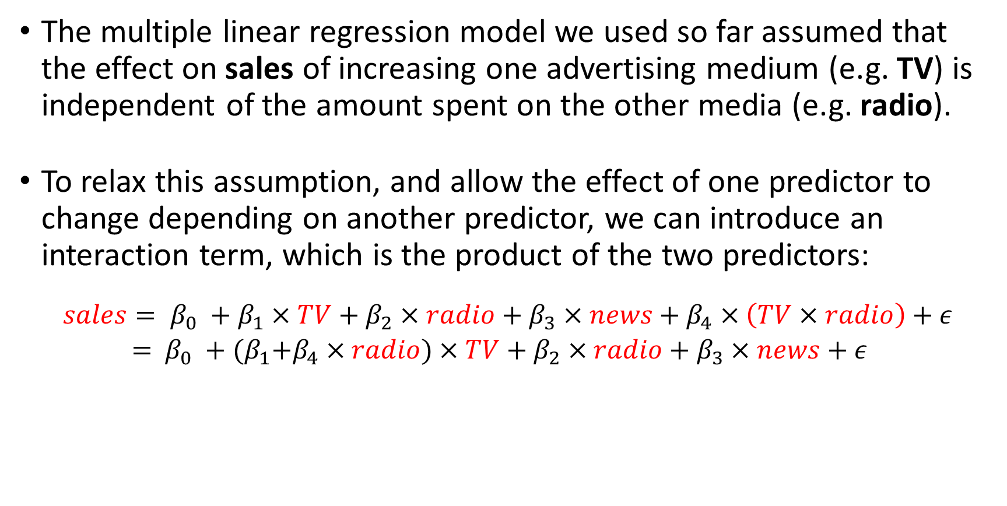
Modelling interactions between the predictors
The multiple linear regression model we used so far assumed that the effect on sales of increasing one advertising medium (e.g. TV) is independent of the amount spent on the other media (e.g. radio).
To relax this assumption, and allow the effect of one predictor to change depending on another predictor, we can introduce an interaction term, which is the product of the two predictors:
$$sales= β_{0} +β_{1}×TV+β_{2}×radio+β_{3}×news+β_{4}×\left(TV×radio\right)+ε$$
$=$ $β_{0} +{(β}_{1}+β_{4}×radio)×TV+β_{2}×radio+β_{3}×news+ε$
Notes:
Go to the model fit summary page and show the average effect on sales of a one-unit increase in TV, regardless of the amount spent on radio.

Slide 35
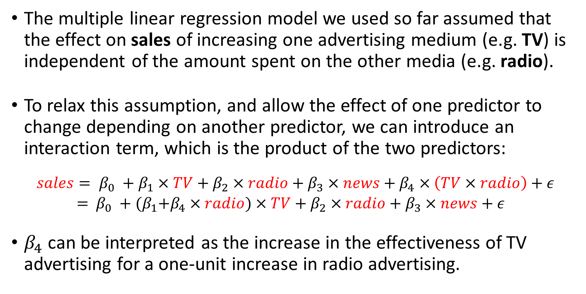
Modelling interactions between the predictors
The multiple linear regression model we used so far assumed that the effect on sales of increasing one advertising medium (e.g. TV) is independent of the amount spent on the other media (e.g. radio).
To relax this assumption, and allow the effect of one predictor to change depending on another predictor, we can introduce an interaction term, which is the product of the two predictors:
$$sales= β_{0} +β_{1}×TV+β_{2}×radio+β_{3}×news+β_{4}×\left(TV×radio\right)+ε$$
$=$ $β_{0} +{(β}_{1}+β_{4}×radio)×TV+β_{2}×radio+β_{3}×news+ε$
$β_{4}$ can be interpreted as the increase in the effectiveness of TV advertising for a one-unit increase in radio advertising.
Notes:
Go to the model fit summary page and show the average effect on sales of a one-unit increase in TV, regardless of the amount spent on radio.

Slide 36
Multiple linear regression in R: Interactions
fit.inter = lm(sales ~ TV + radio + TV:radio + newspaper, data = Advertising)
summary(fit.inter)
Residuals:
Min 1Q Median 3Q Max
-6.293 -0.398 0.181 0.596 1.501
Coefficients:
Estimate Std. Error t value Pr(>|t|)
(Intercept) 6.7284119 0.2533195 26.56 <2e-16 ***
TV 0.0190668 0.0015093 12.63 <2e-16 ***
radio 0.0279917 0.0091412 3.06 0.0025 **
newspaper 0.0014442 0.0032955 0.44 0.6617
TV:radio 0.0010873 0.0000526 20.69 <2e-16 ***
---
Signif. codes: 0 ‘***’ 0.001 ‘**’ 0.01 ‘*’ 0.05 ‘.’ 0.1 ‘ ’ 1
Residual standard error: 0.945 on 195 degrees of freedom
Multiple R-squared: 0.968, Adjusted R-squared: 0.967
F-statistic: 1.47e+03 on 4 and 195 DF, p-value: <2e-16

Slide 37
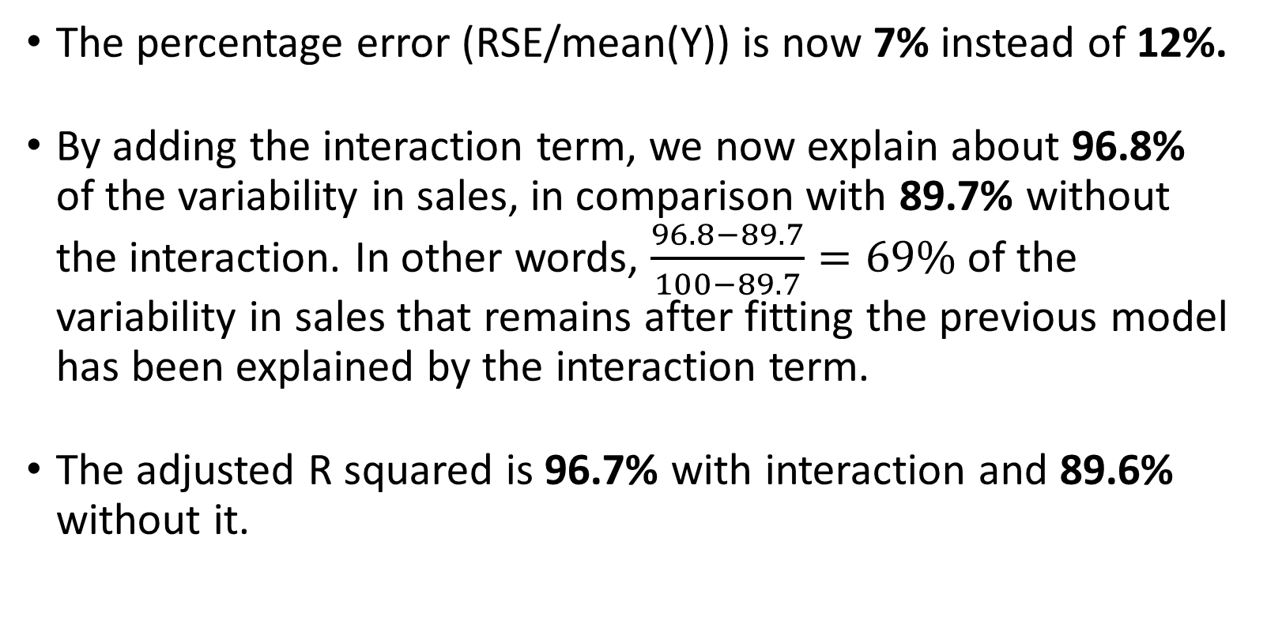
Multiple linear regression in R: Interactions
The percentage error (RSE/mean(Y)) is now 7% instead of 12%.
By adding the interaction term, we now explain about 96.8% of the variability in sales, in comparison with 89.7% without the interaction. In other words, $\frac{96.8−89.7}{100−89.7}=69\%$ of the variability in sales that remains after fitting the previous model has been explained by the interaction term.
The adjusted R squared is 96.7% with interaction and 89.6% without it.

Slide 38
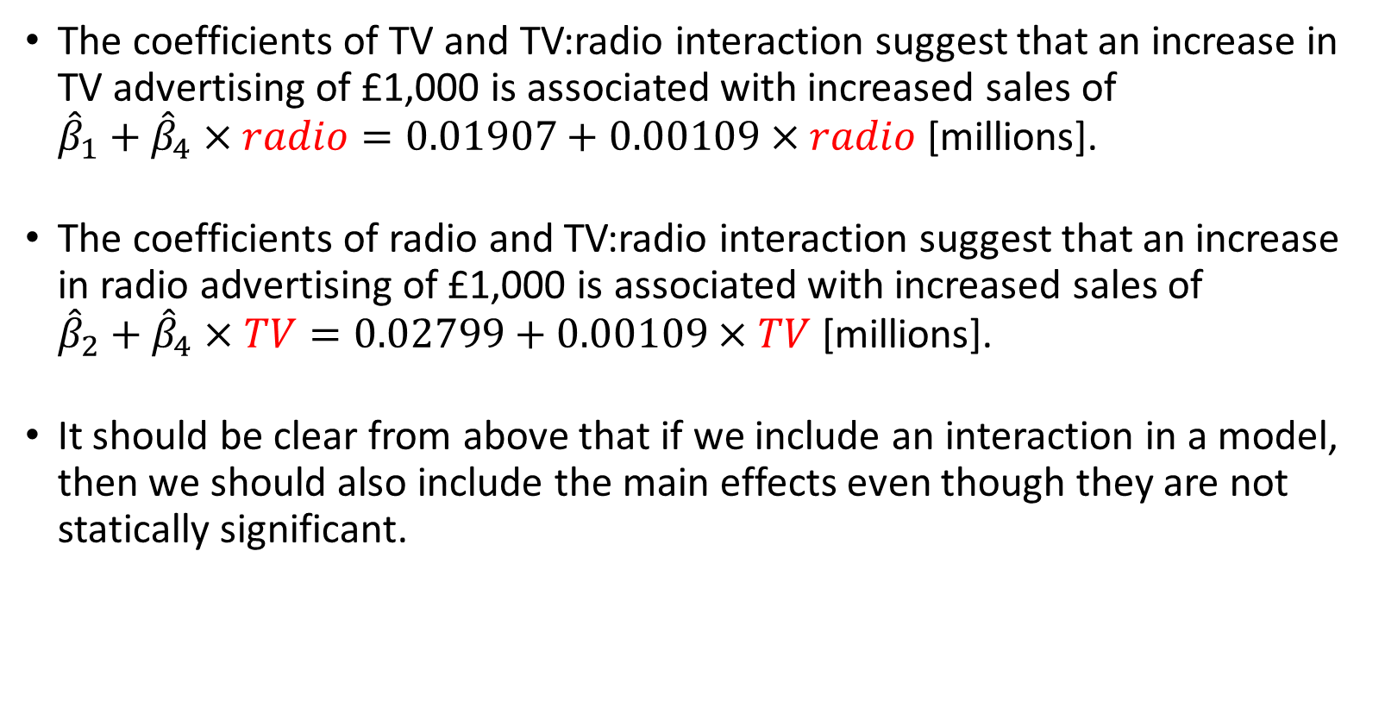
Multiple linear regression in R: Interactions
The coefficients of TV and TV:radio interaction suggest that an increase in TV advertising of £1,000 is associated with increased sales of ${\hat{β}}_{1}+{\hat{β}}_{4}×radio=0.01907+0.00109×radio$ [millions].
The coefficients of radio and TV:radio interaction suggest that an increase in radio advertising of £1,000 is associated with increased sales of ${\hat{β}}_{2}+{\hat{β}}_{4}×TV=0.02799+0.00109×TV$ [millions].
It should be clear from above that if we include an interaction in a model, then we should also include the main effects even though they are not statically significant.

Slide 39
Task:
Add an interaction term between chi and age to your previous multiple linear regression model.

Slide 40
Outline for our next tutorial
Adding categorical predictors
Interactions between a continuous and categorical predictor
Where it can go wrong (checking model assumptions)

